Slide 1

Analysis of Health Care Entrepreneurship; Angelist.com
Will Bartlett

Slide 2
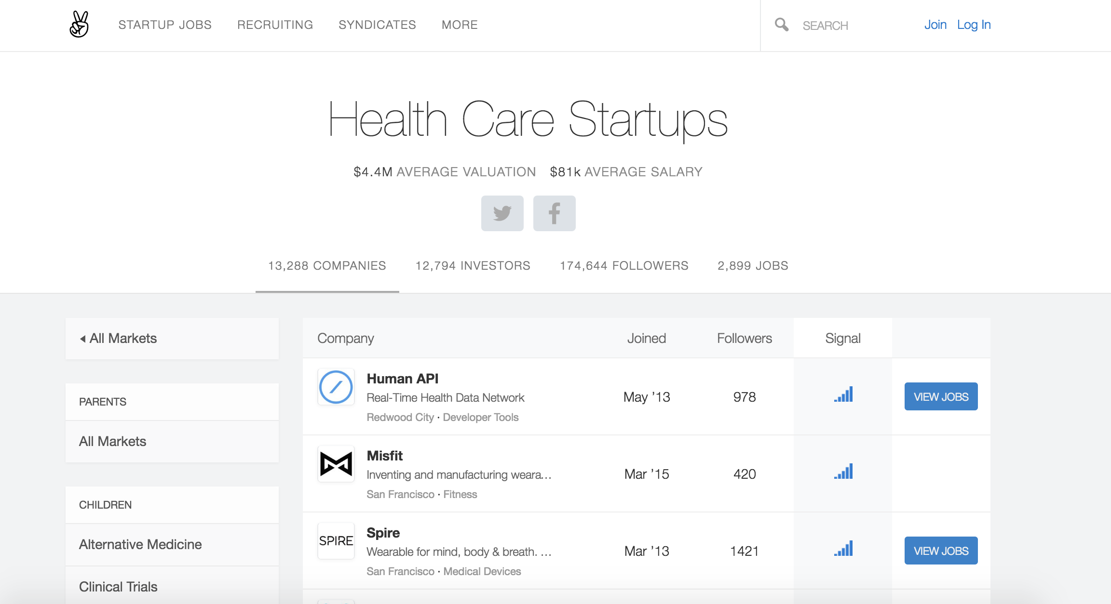

Slide 3
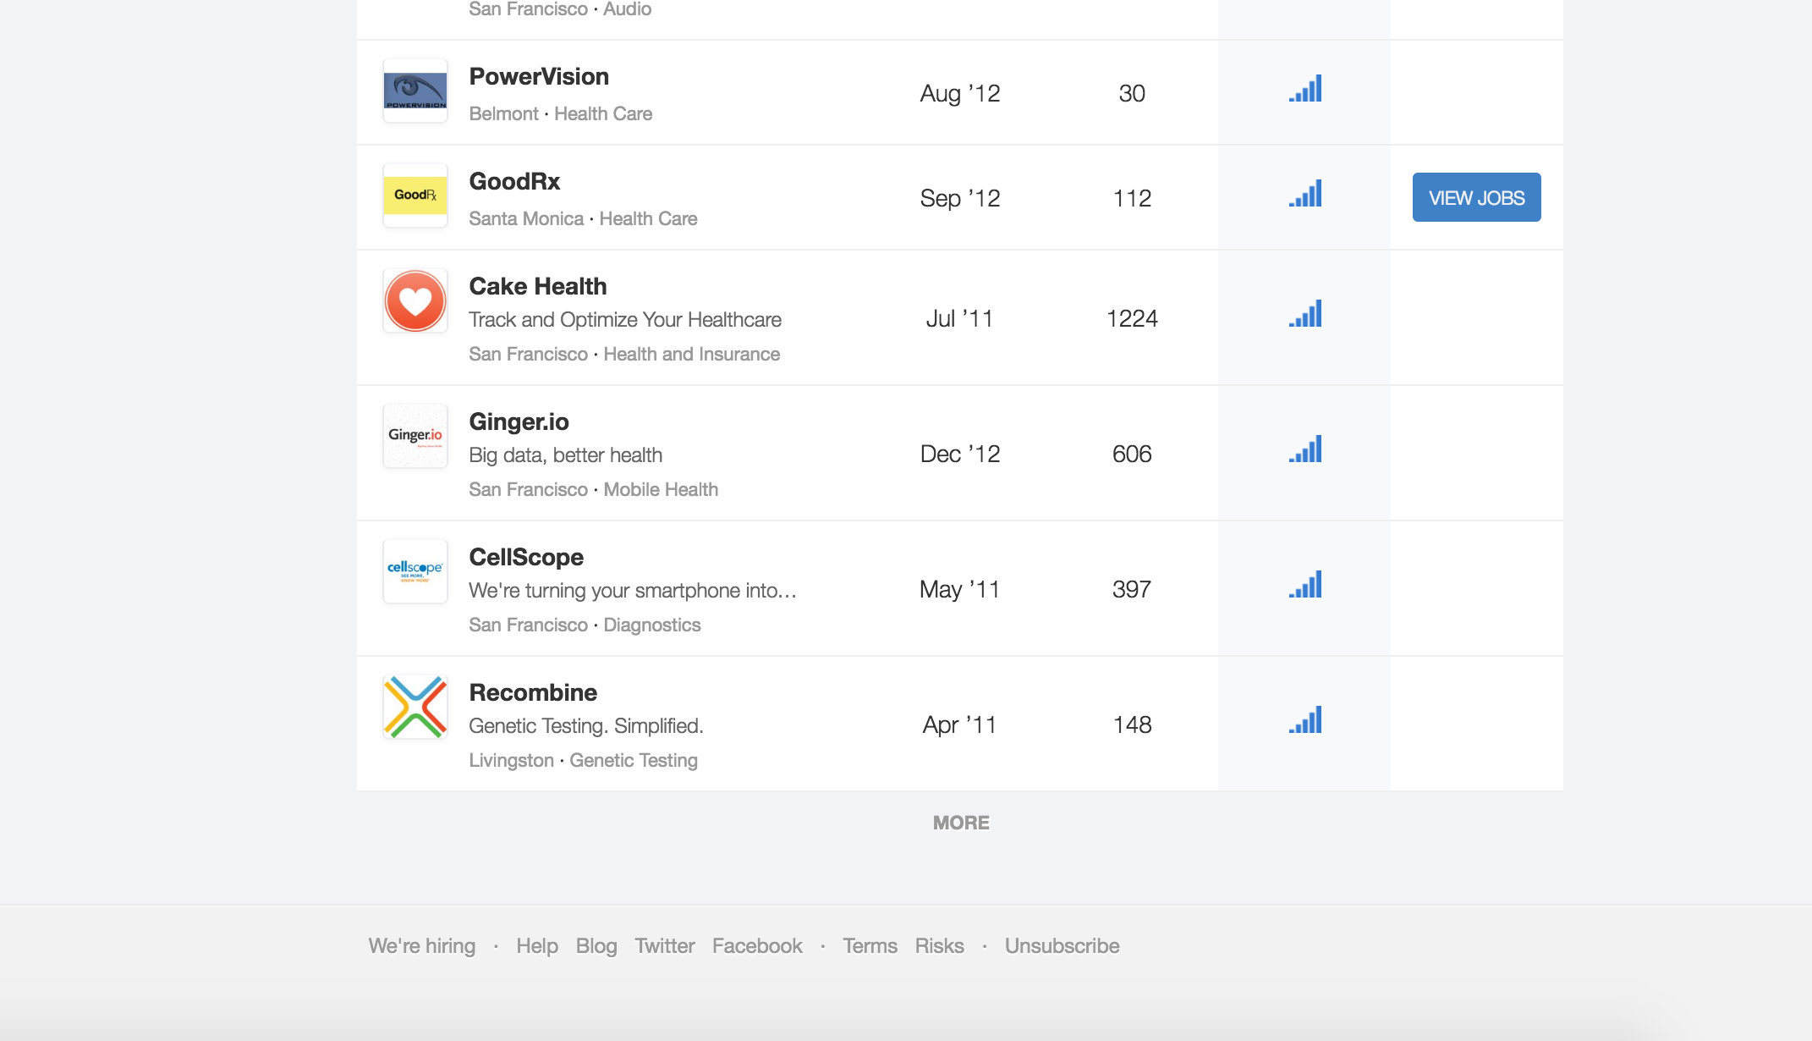

Slide 4
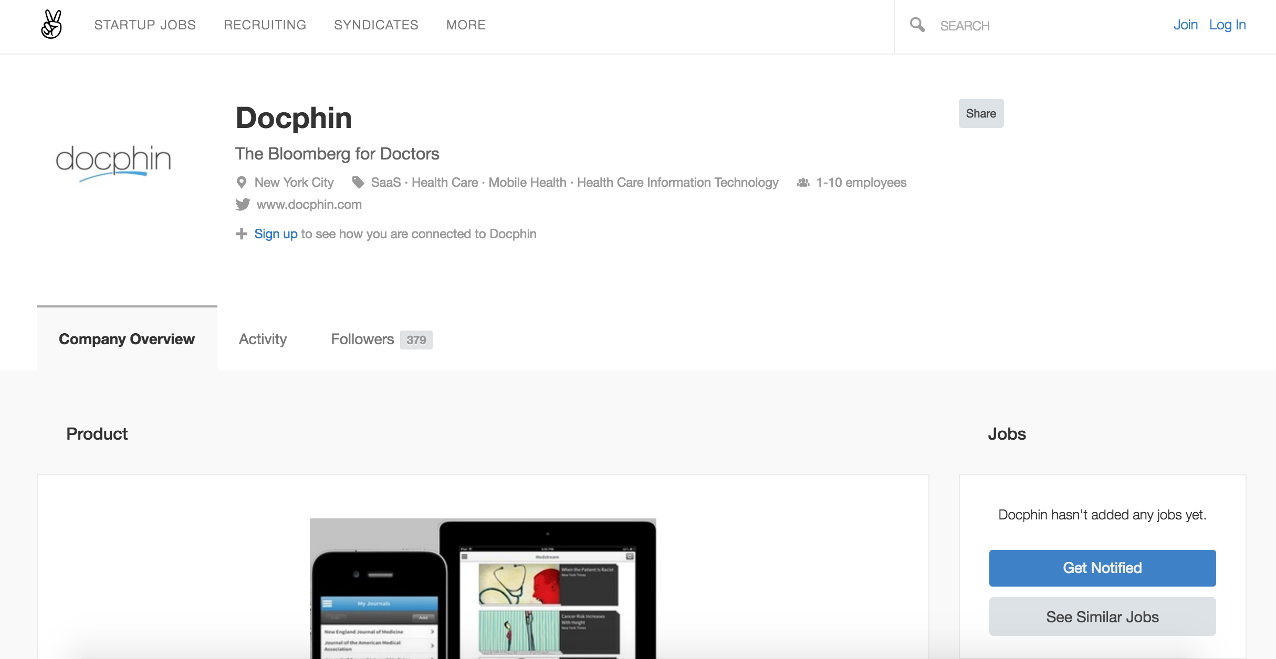

Slide 5
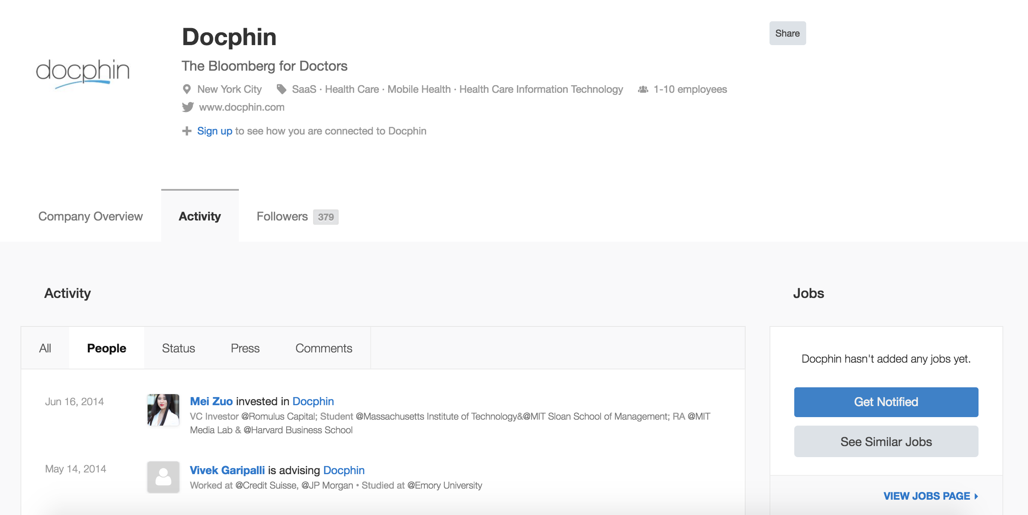

Slide 6
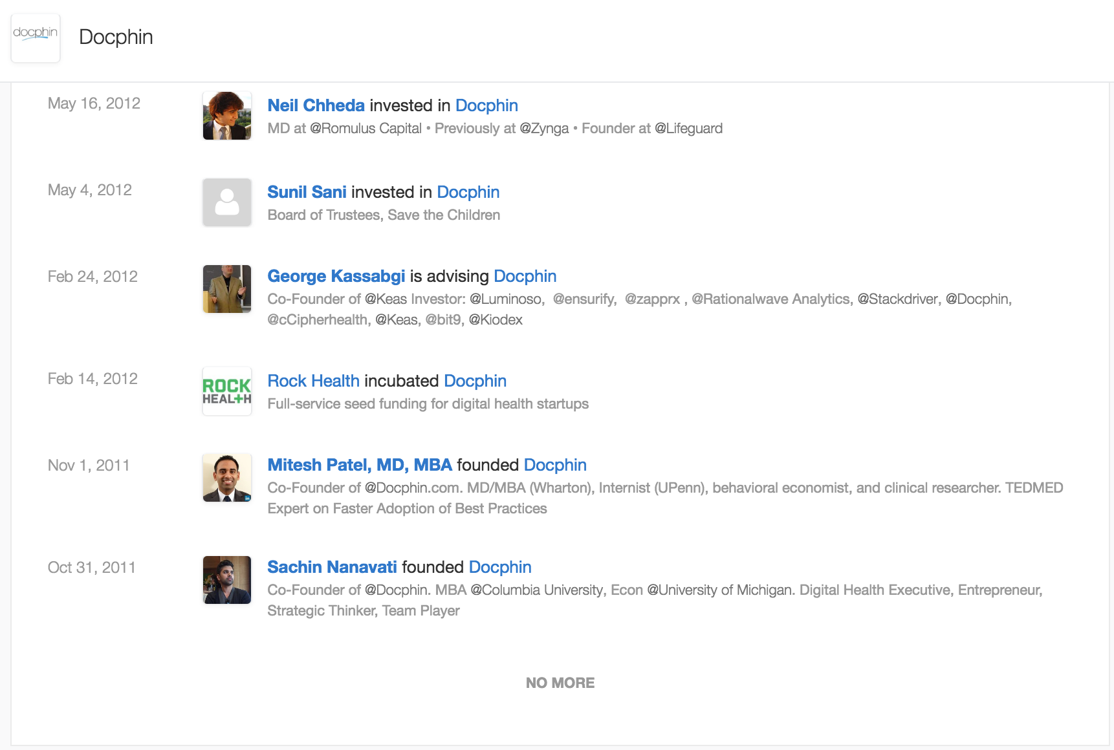

Slide 7
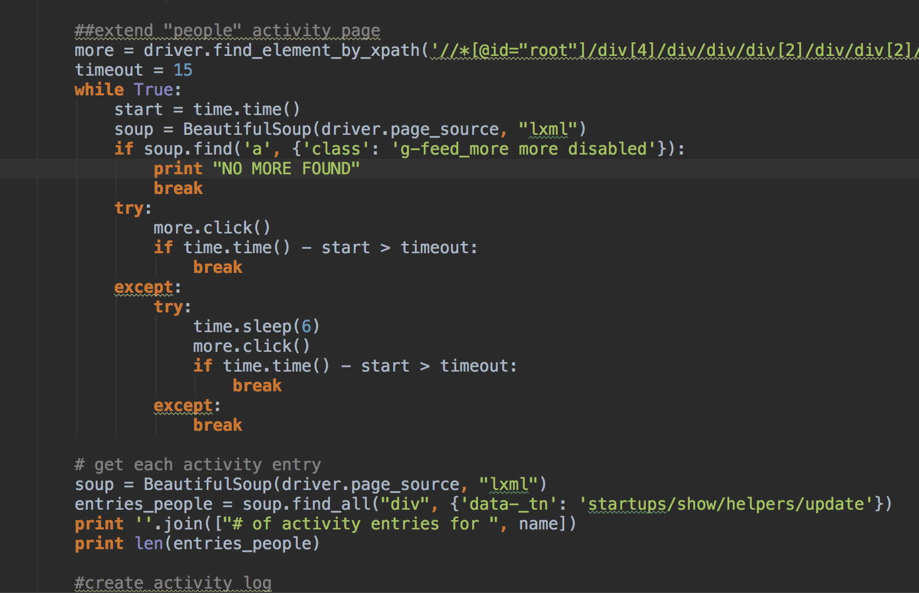

Slide 8
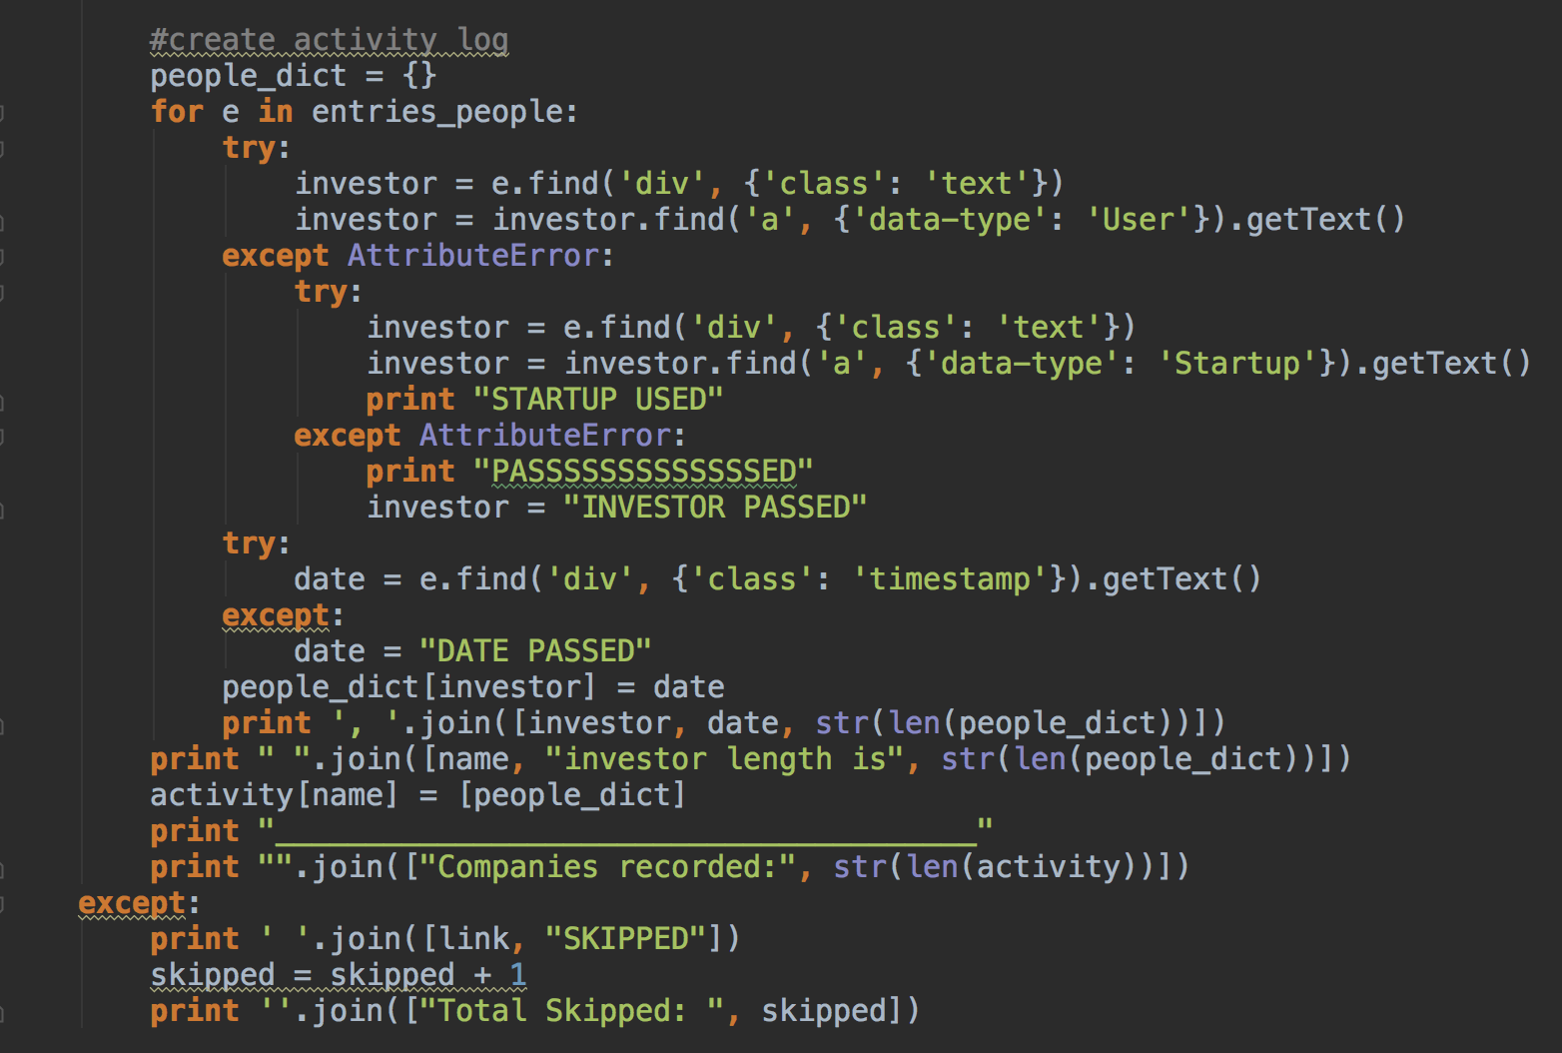
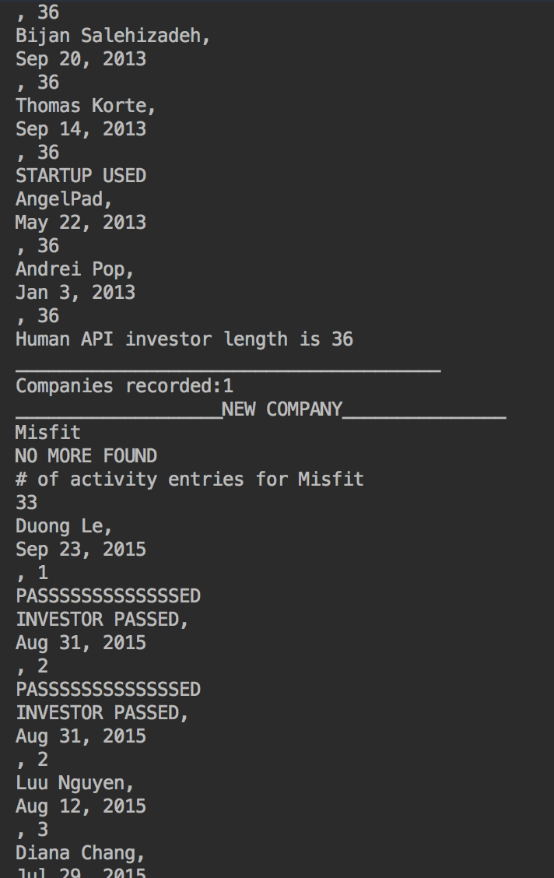

Slide 9
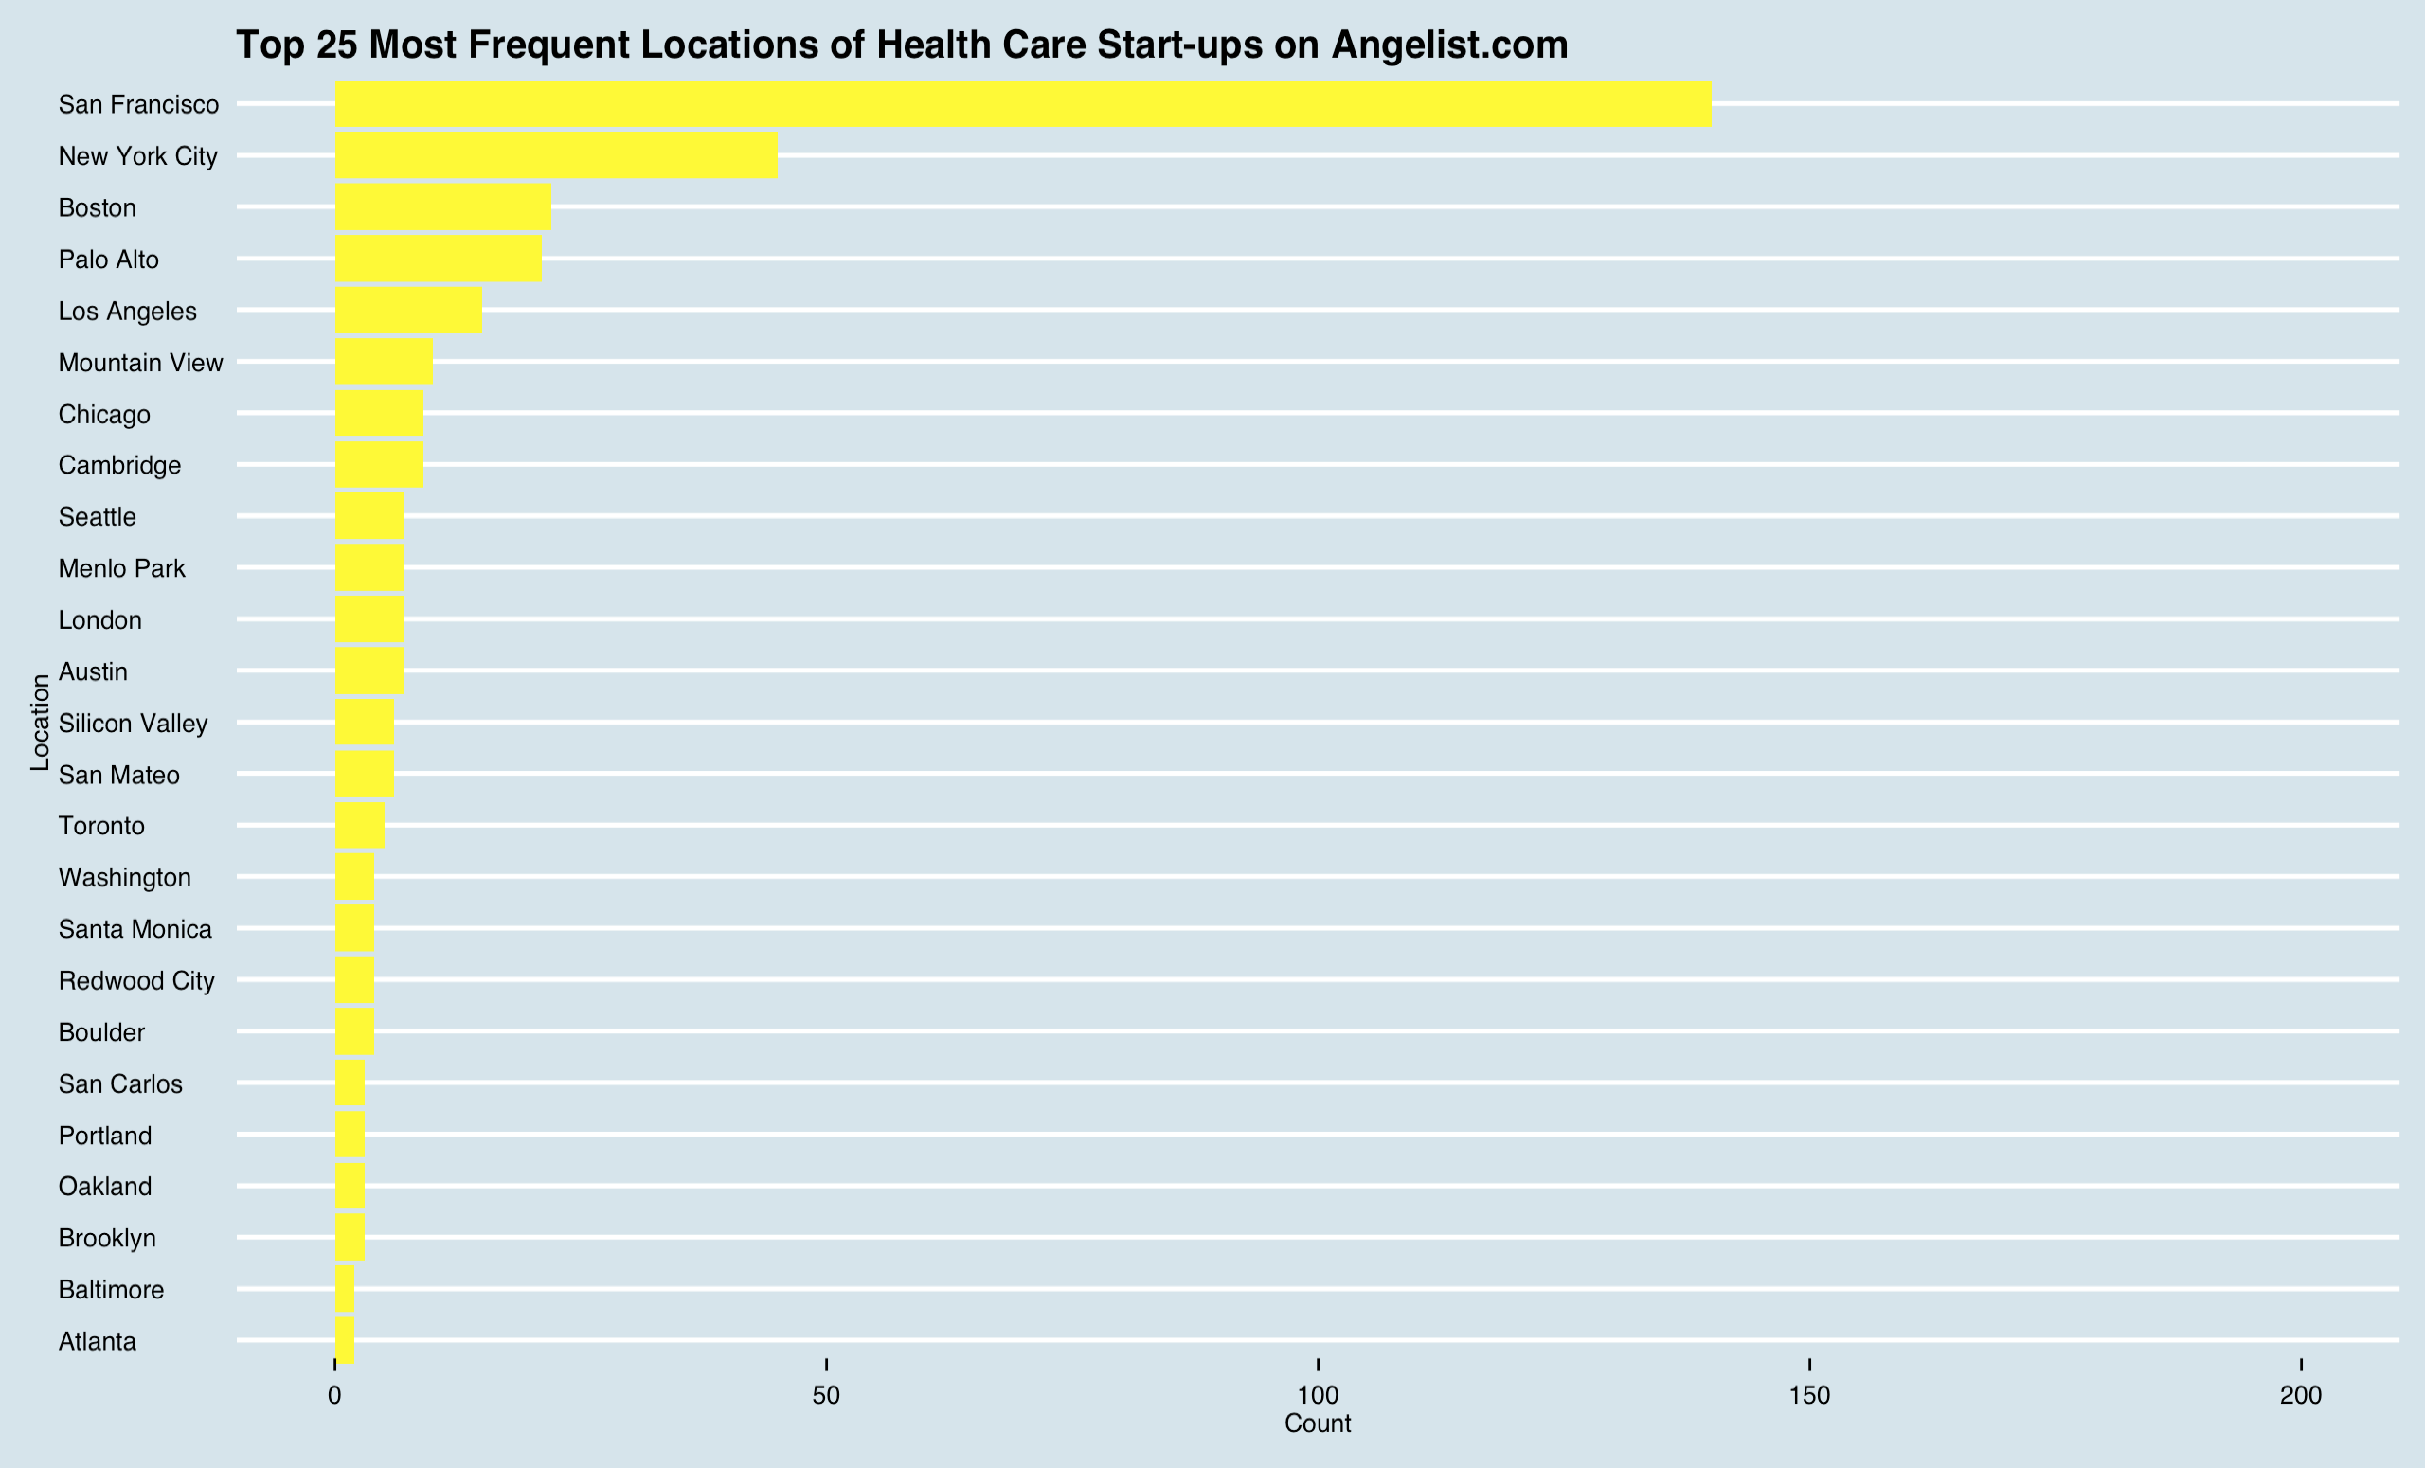

Slide 10
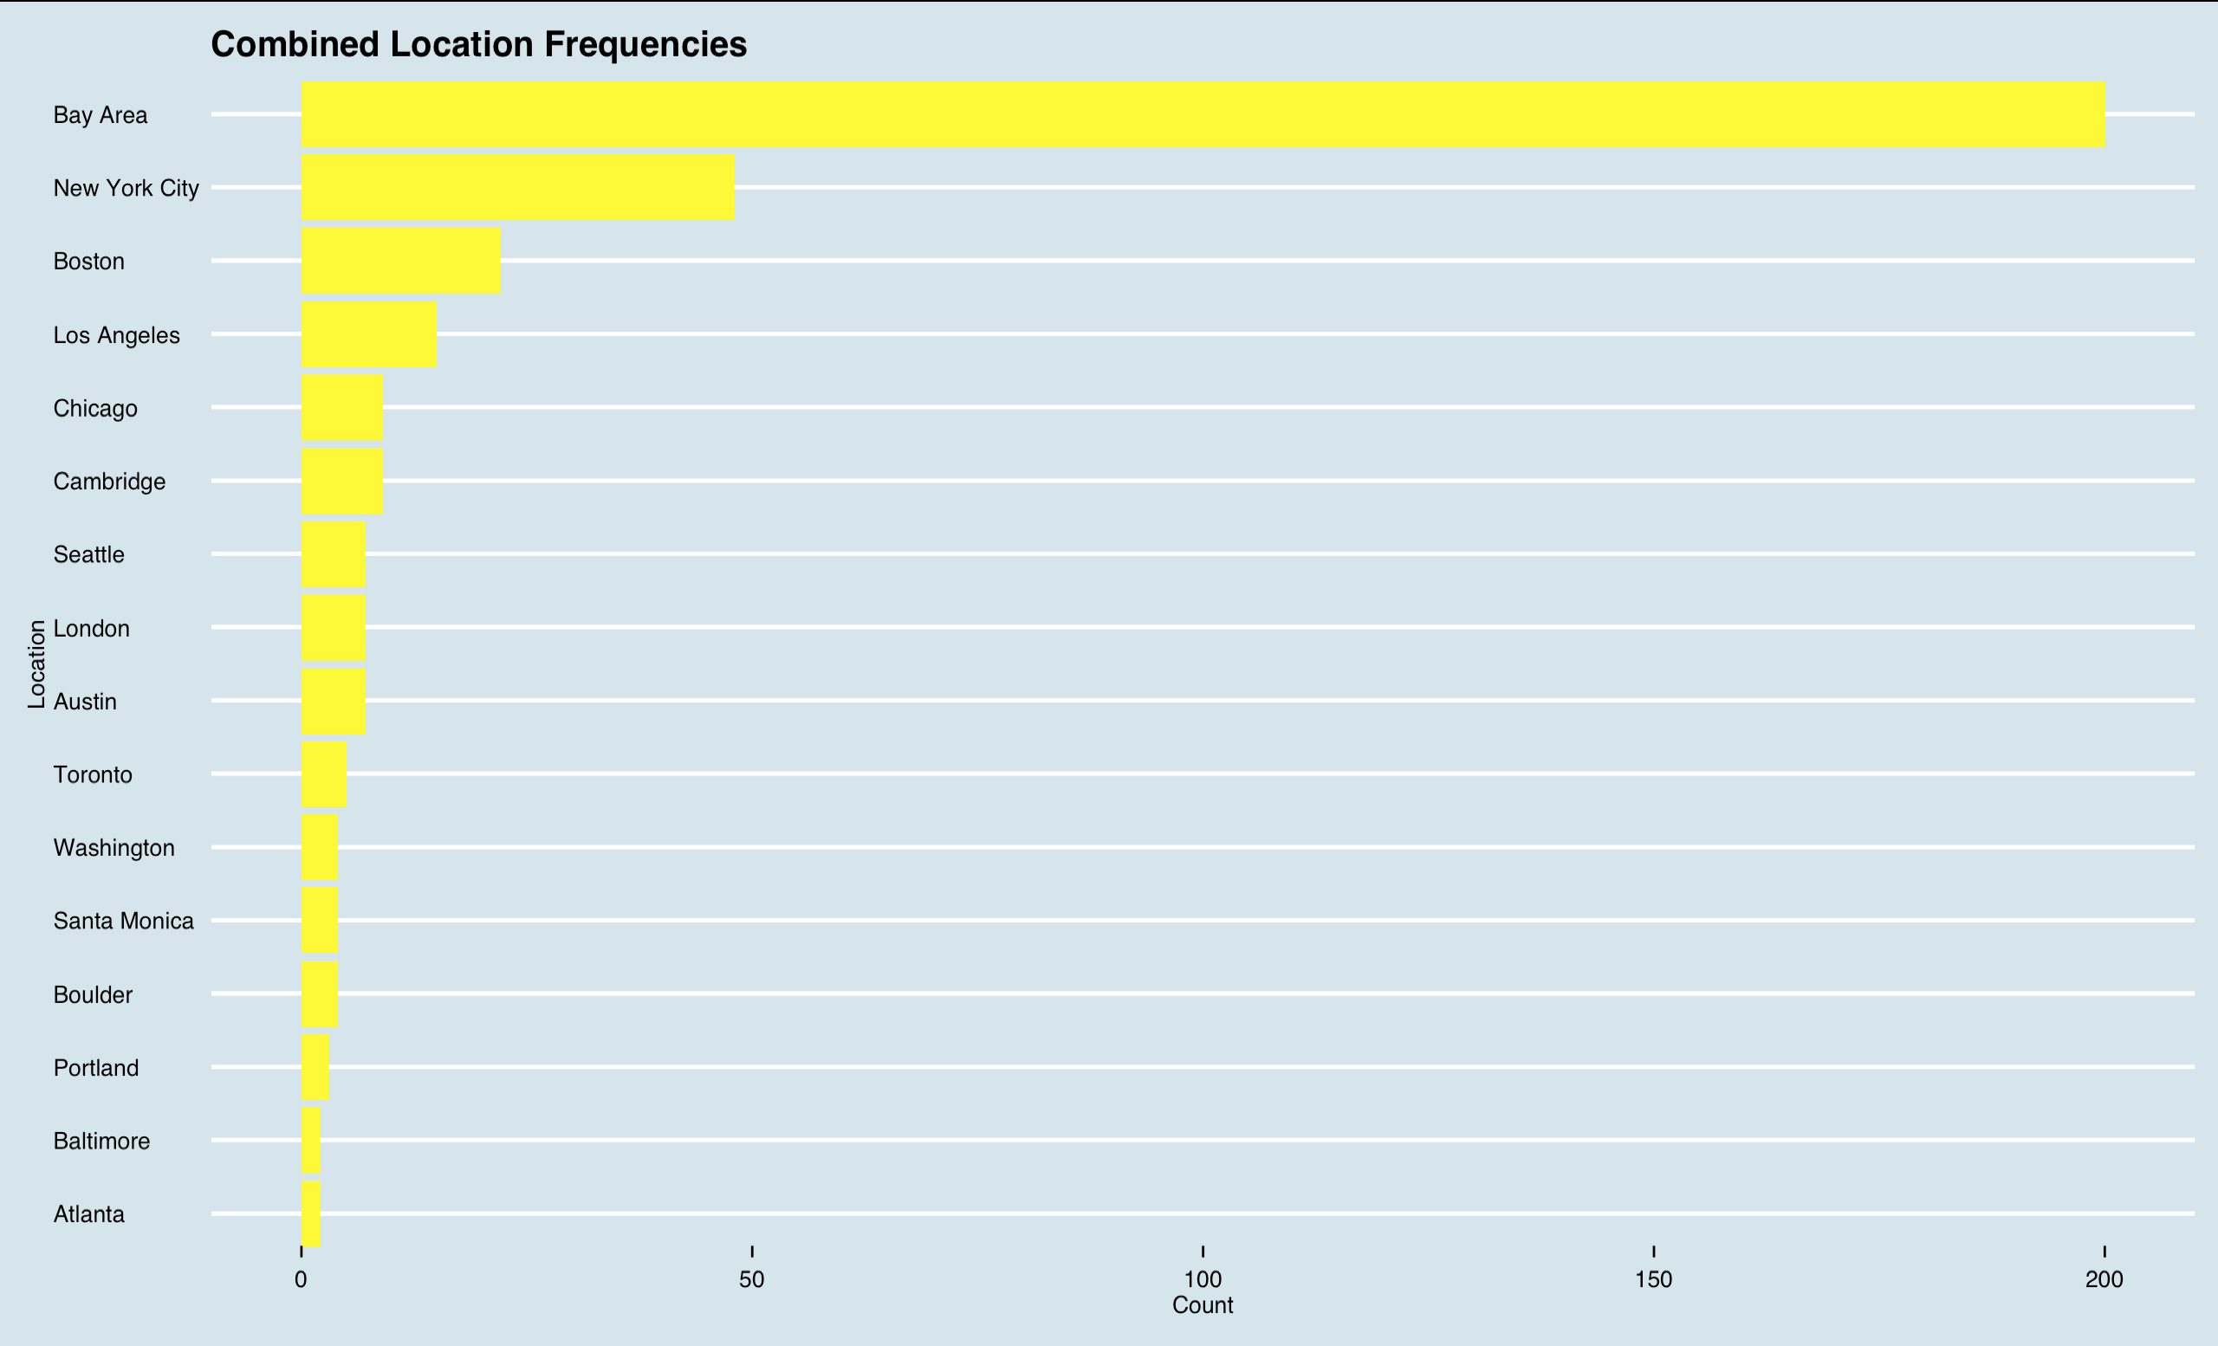

Slide 11
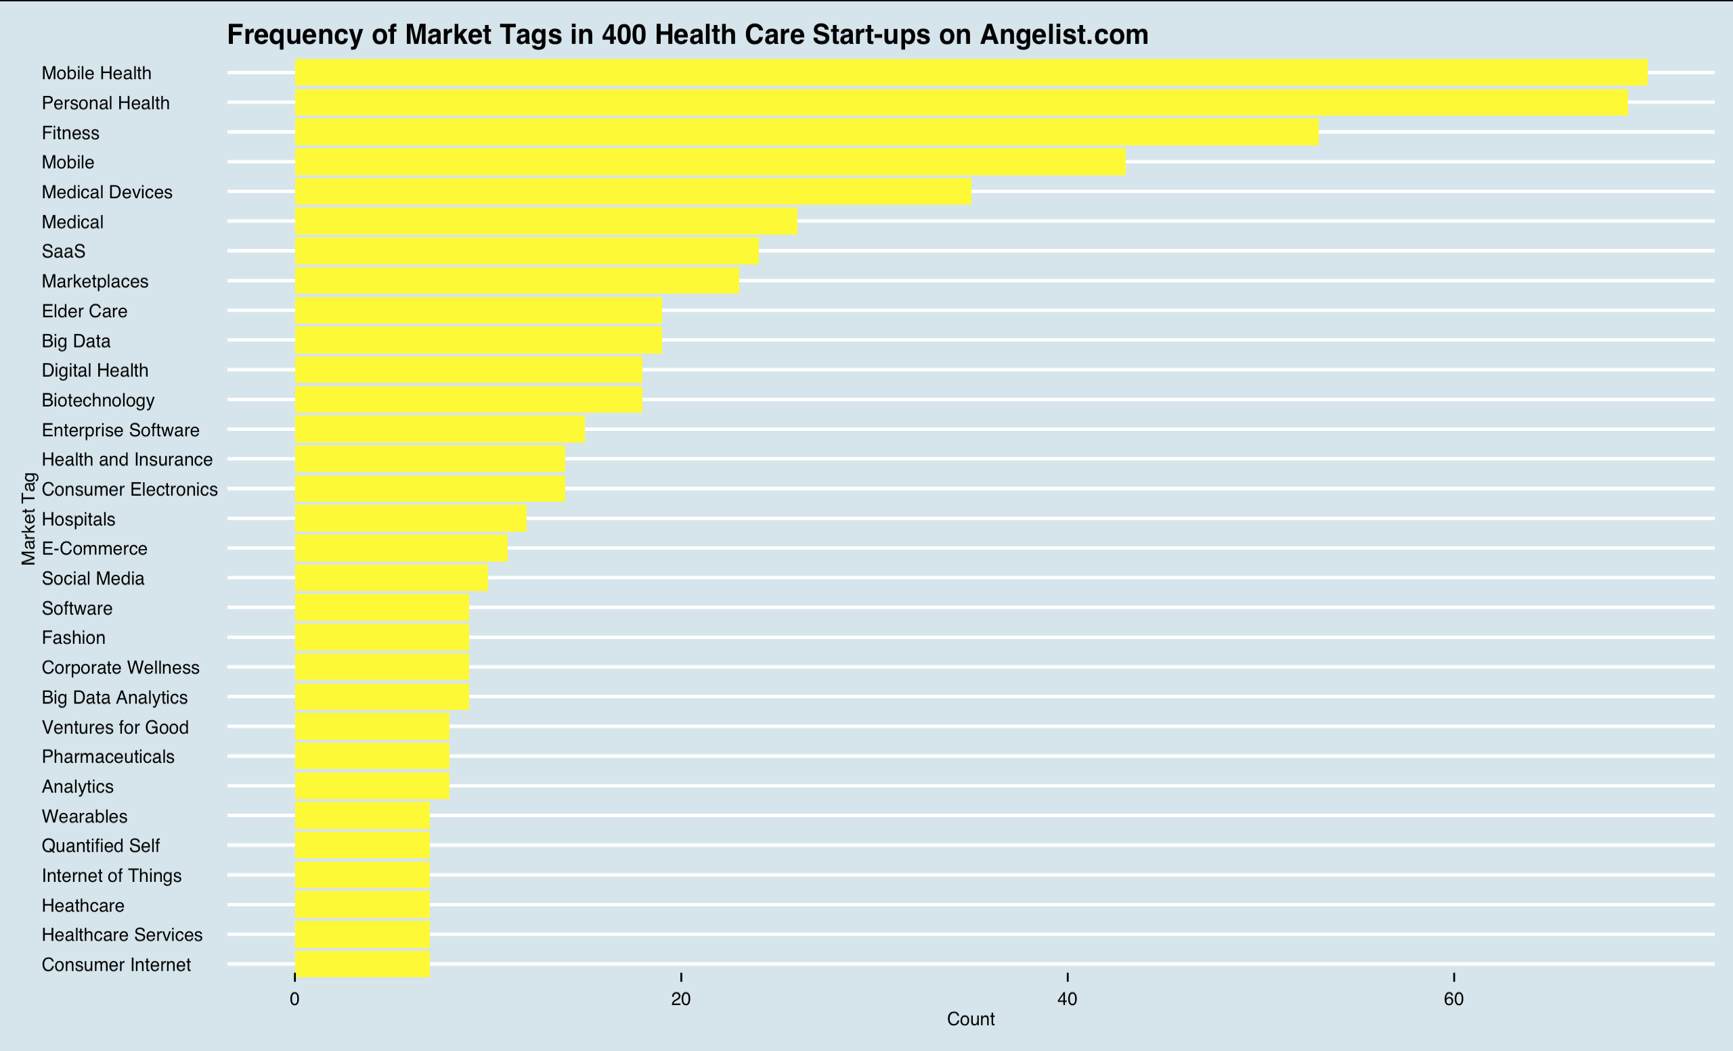
Genetics / Genomics?

Slide 12
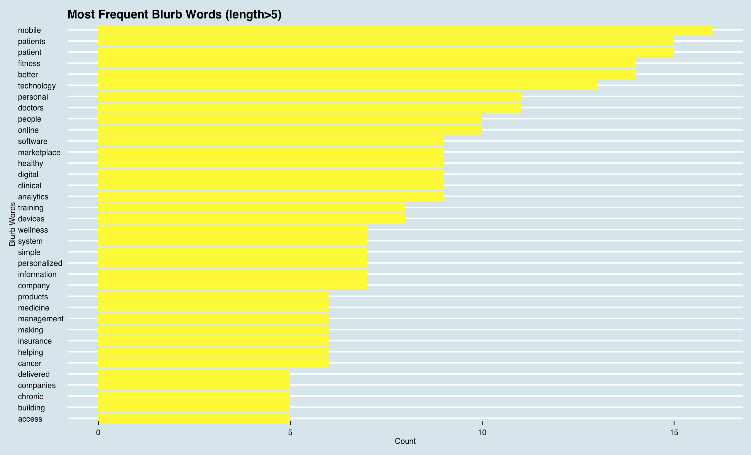

Slide 13
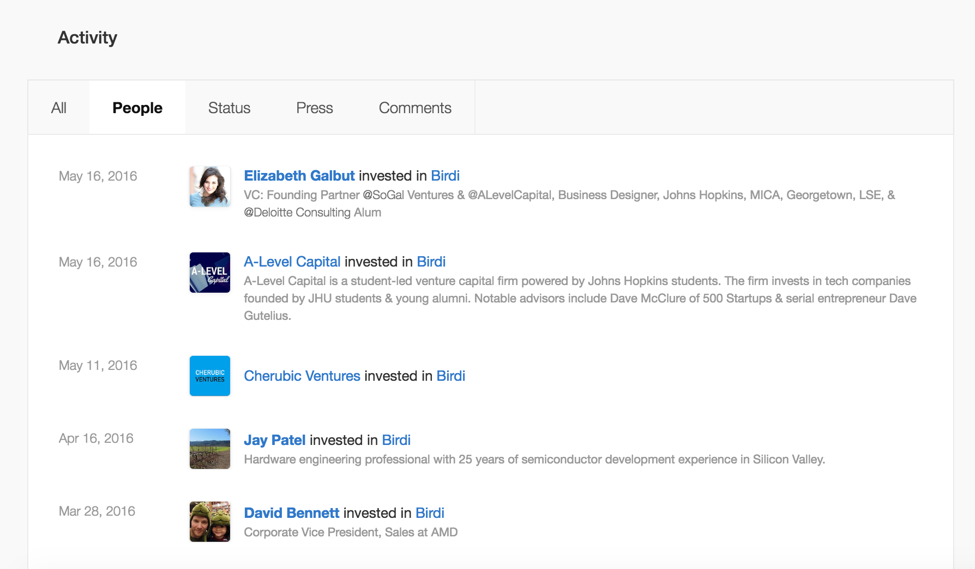

Slide 14
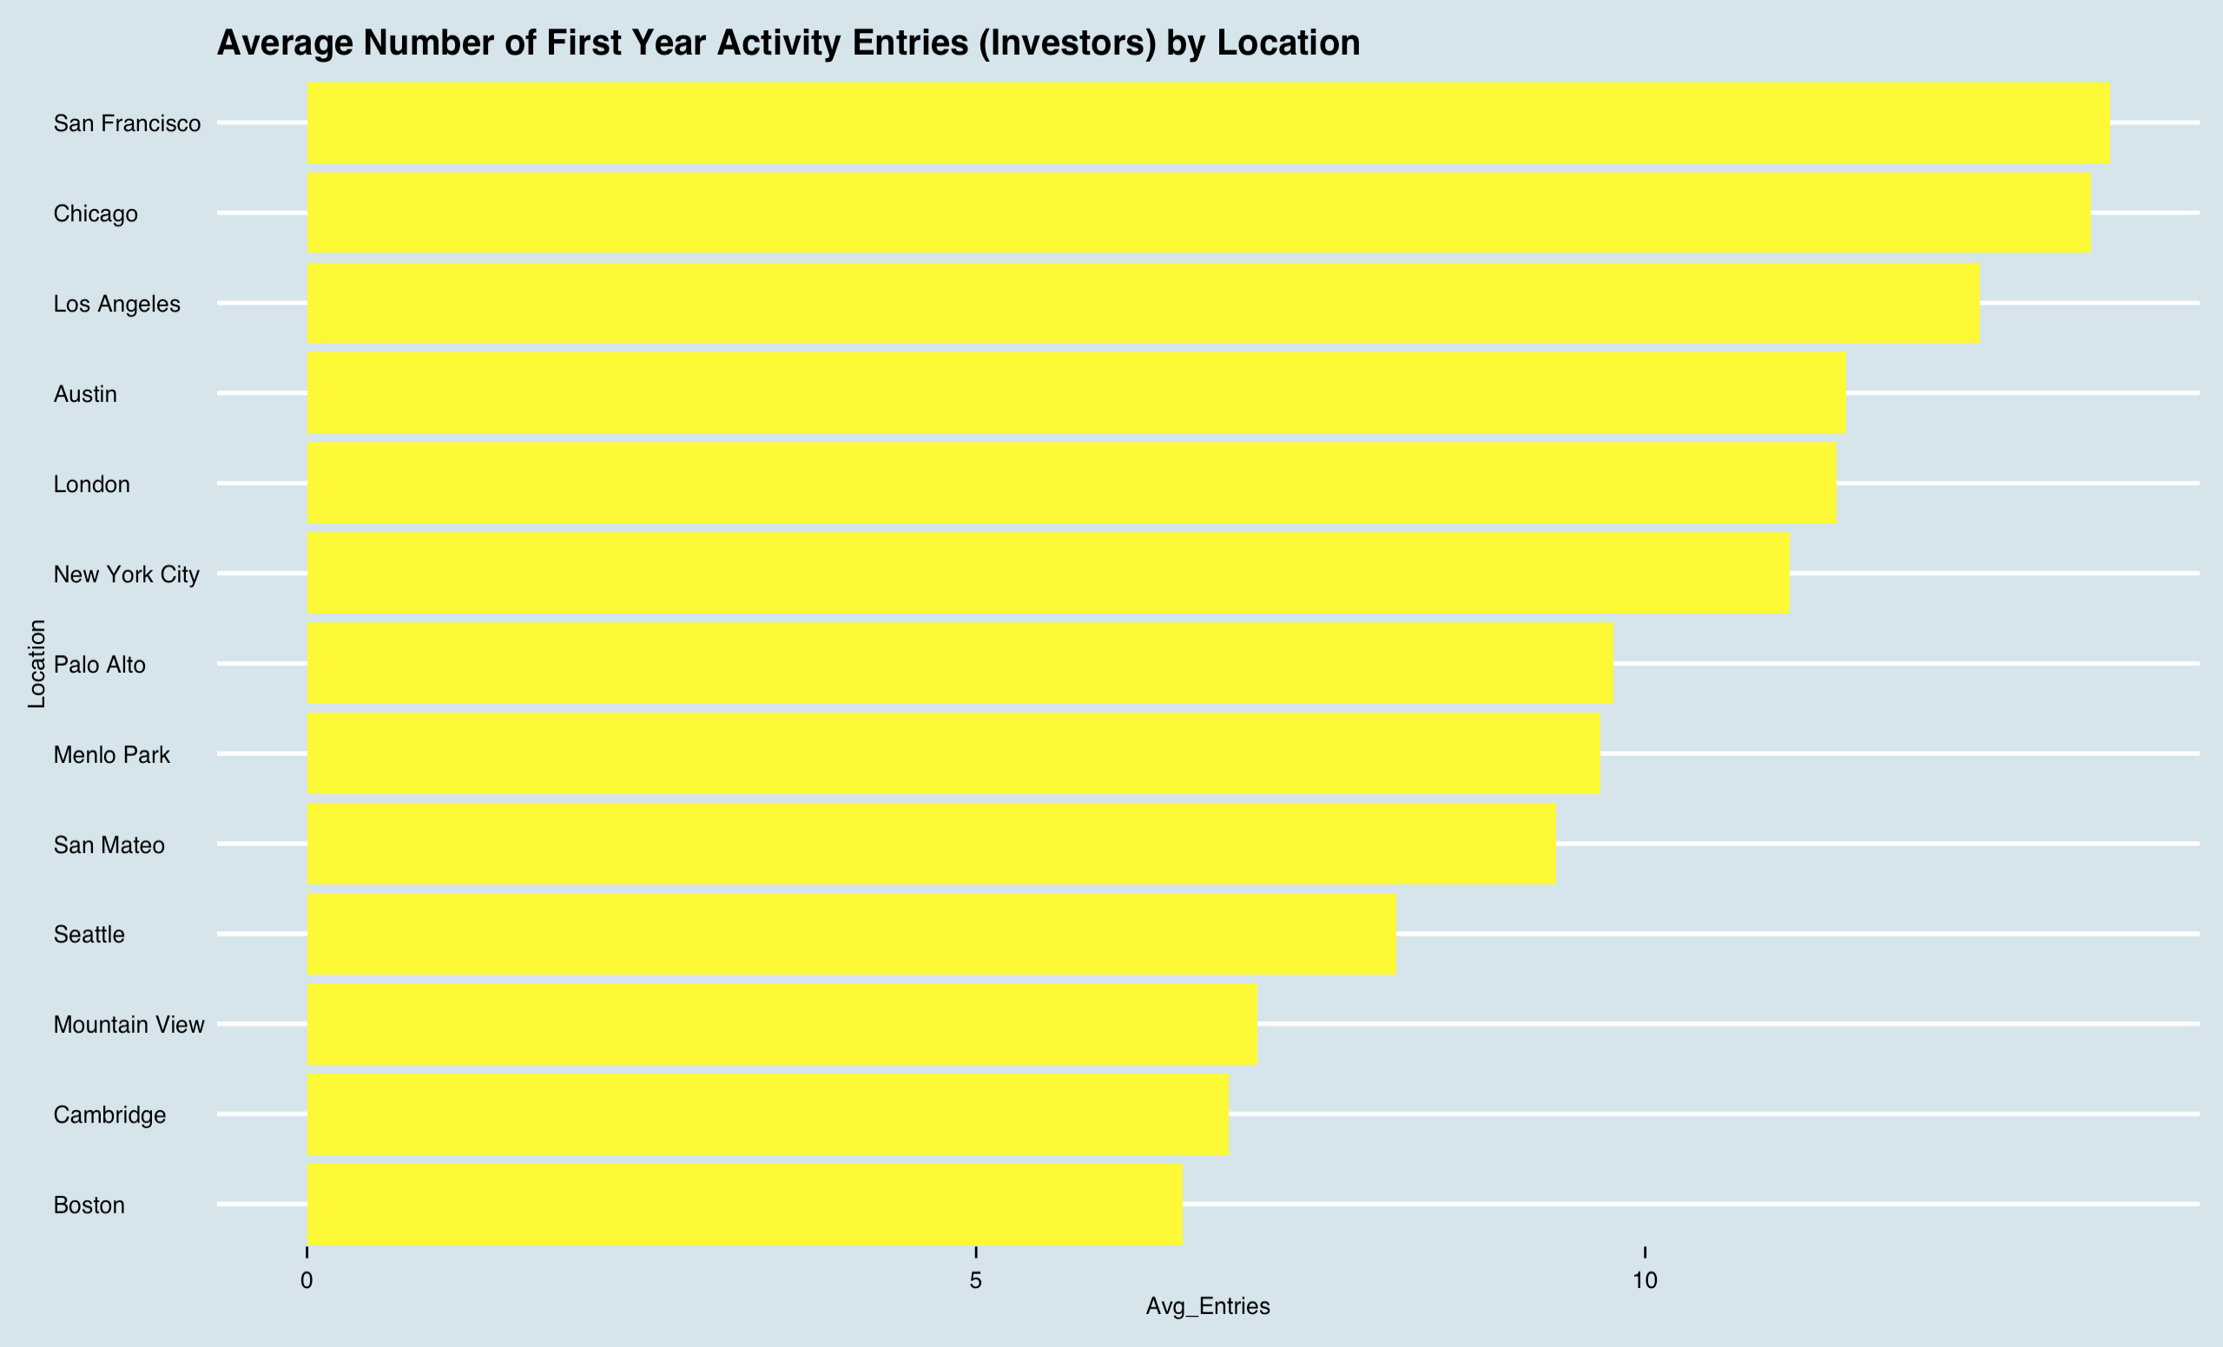

Slide 15
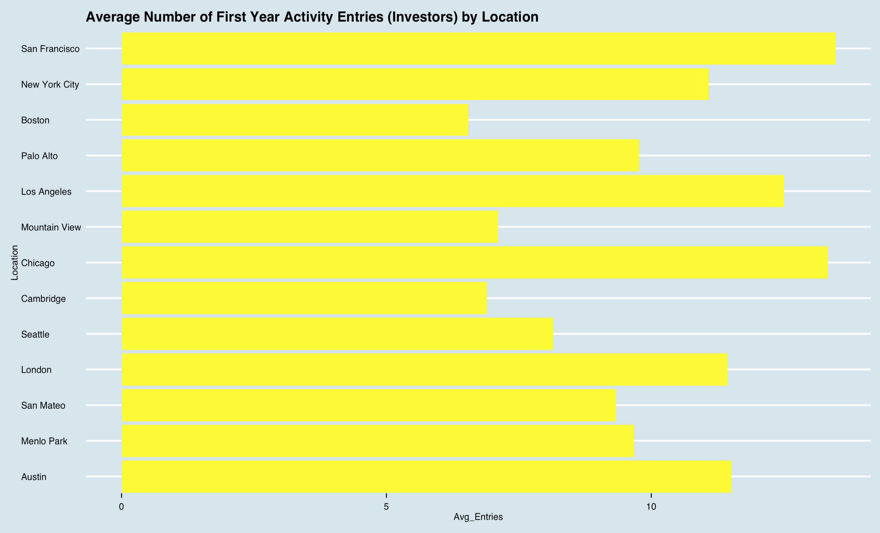

Slide 16
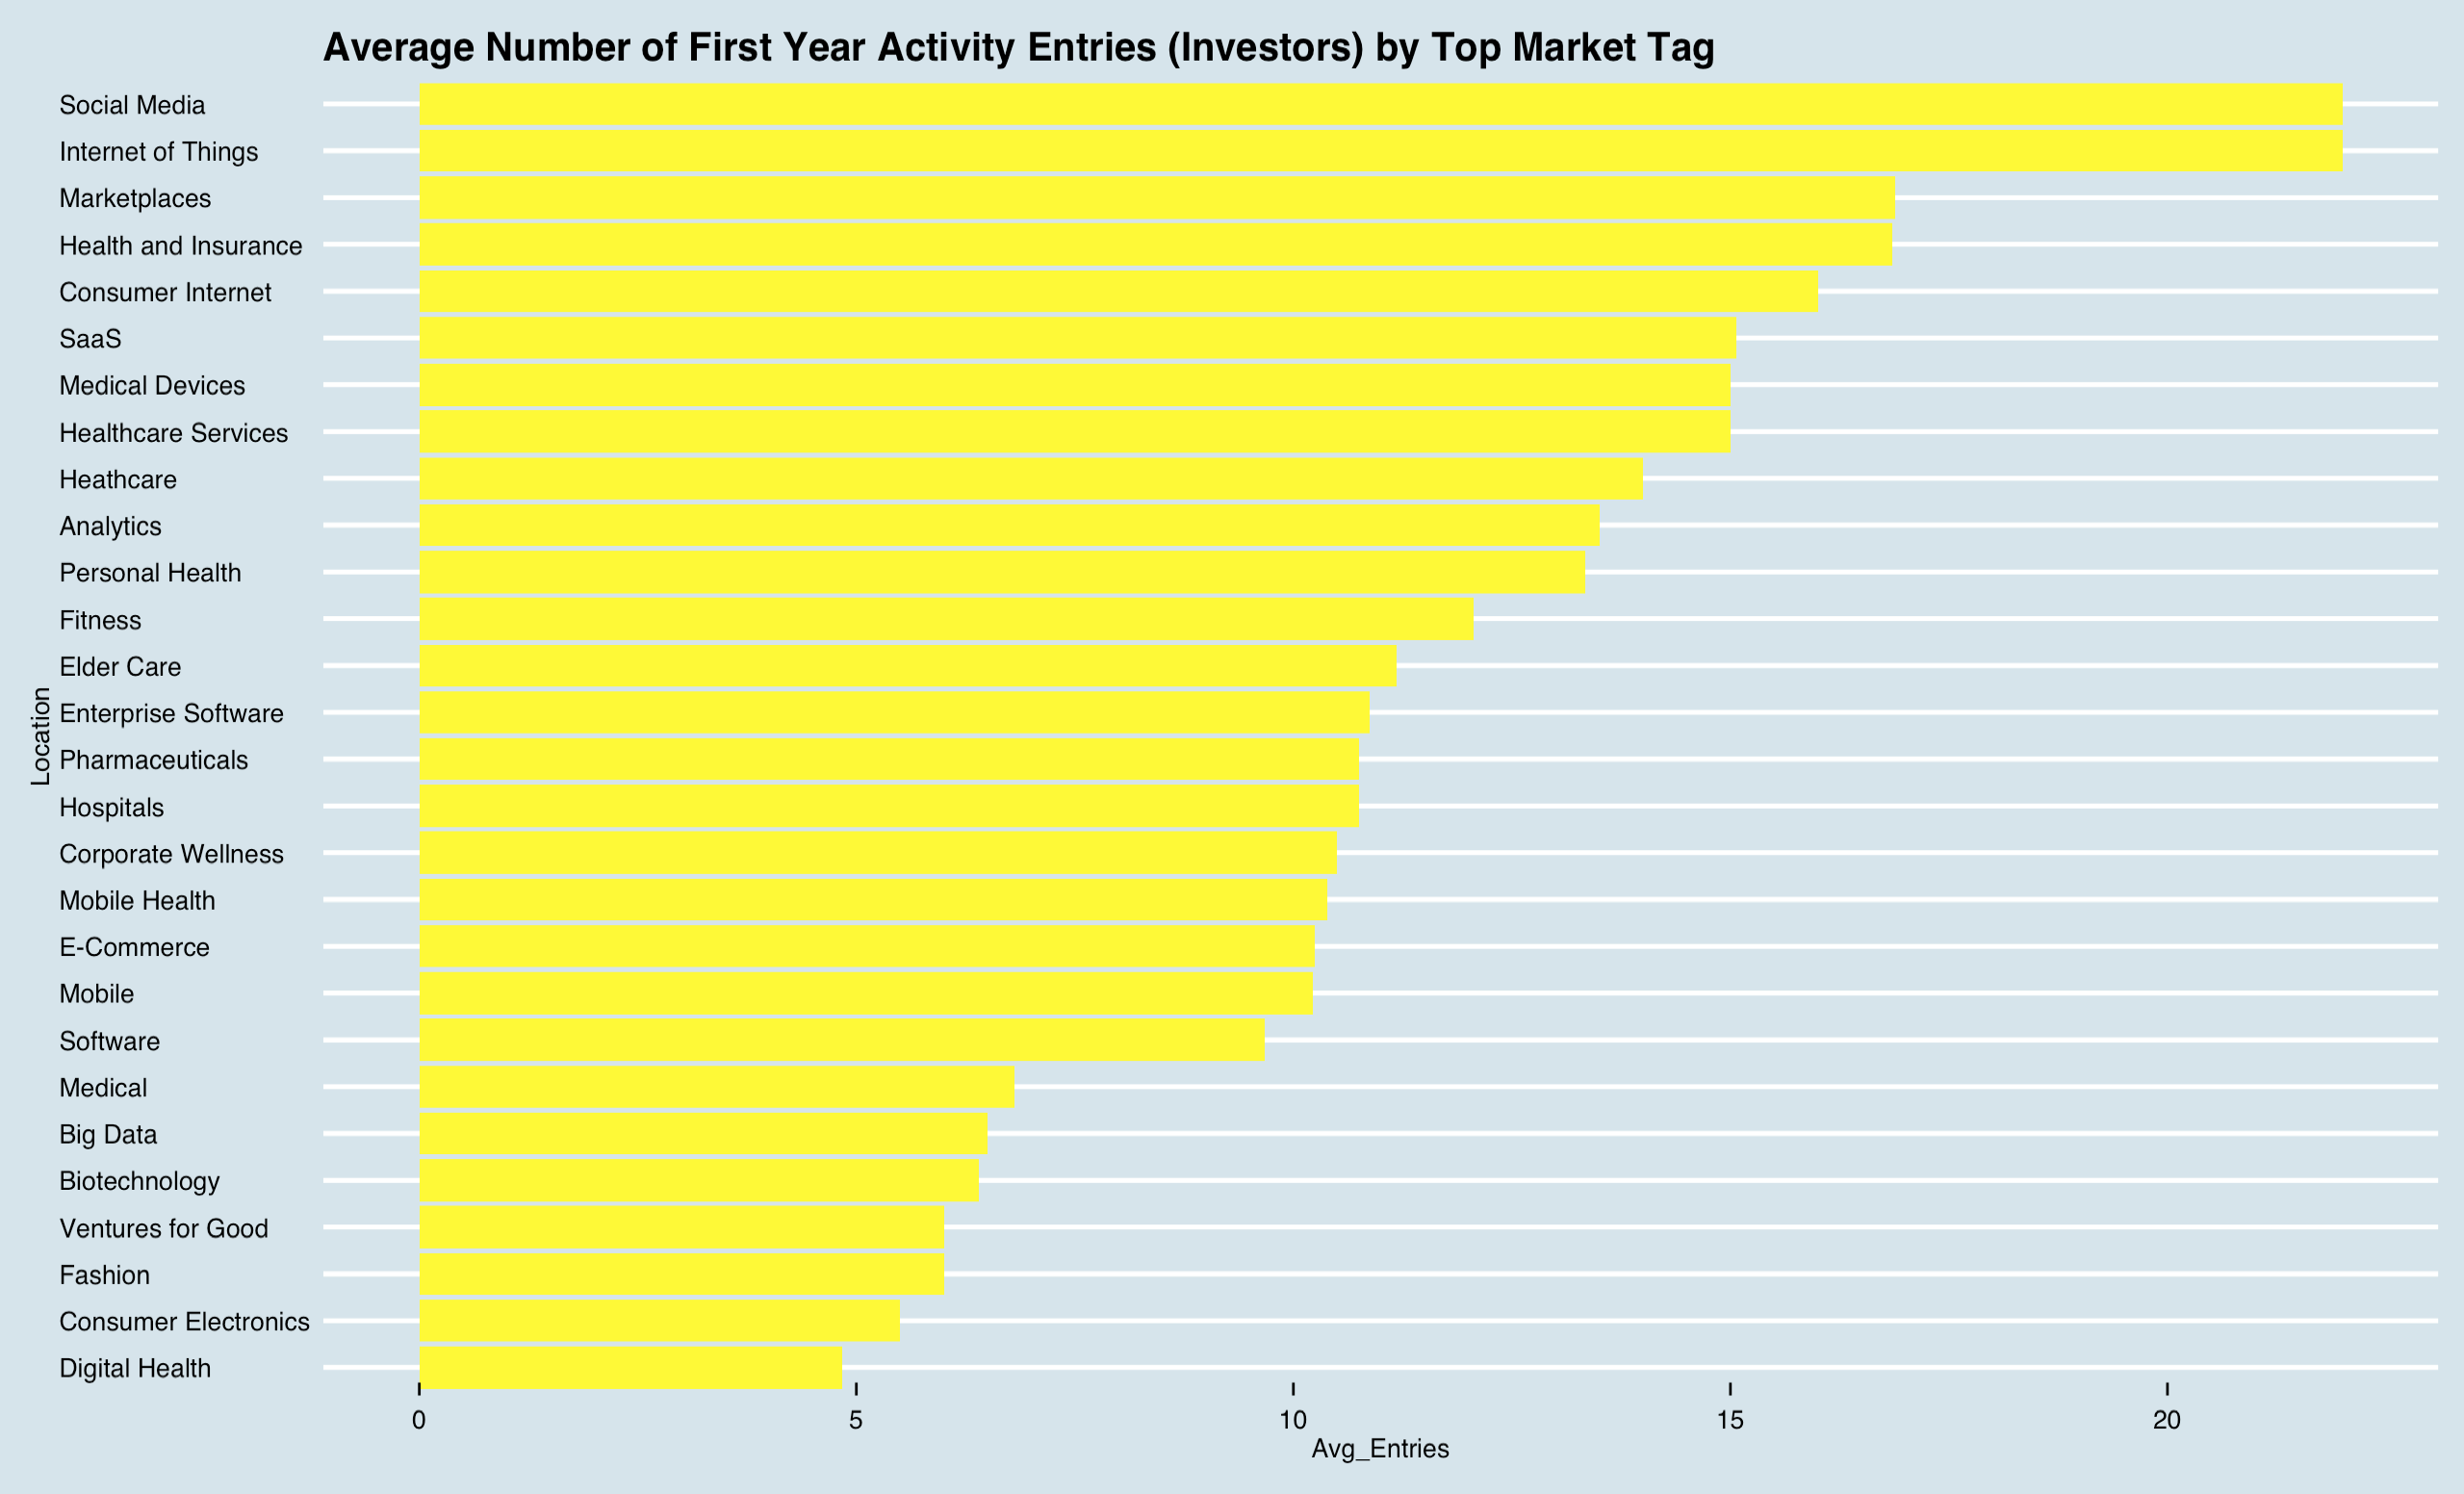

Slide 17
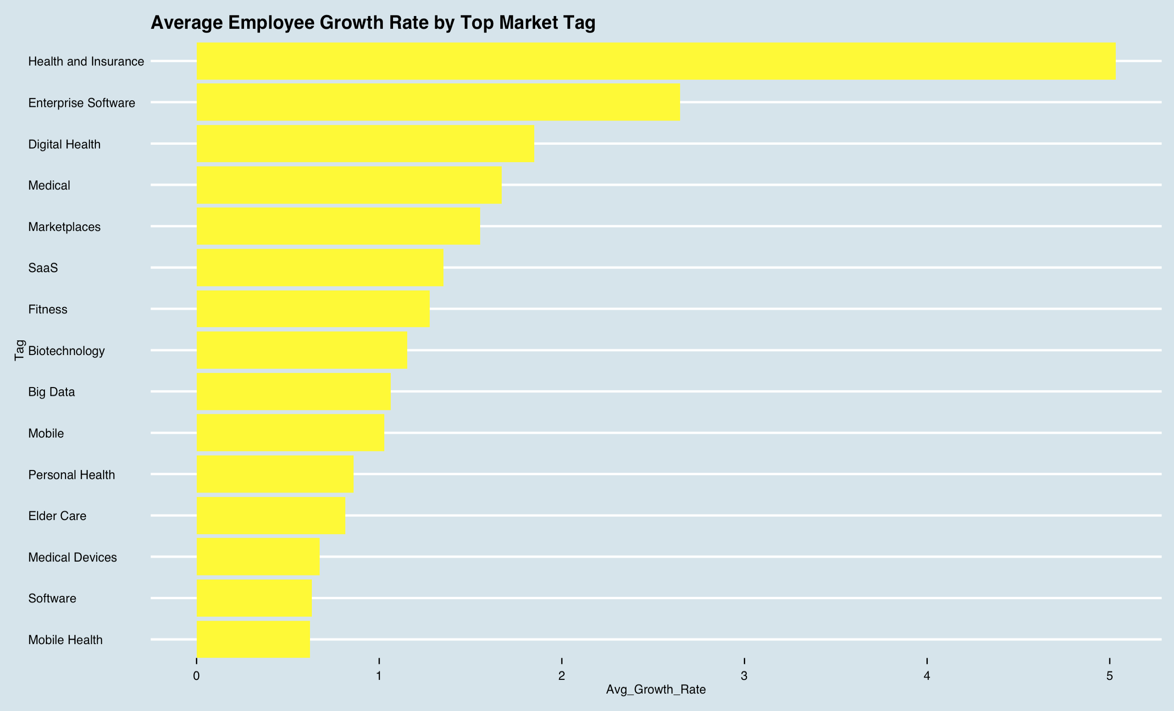

Slide 18
Observations
Bay Area
Mobile Apps
Operational Flow/Delivery
Elder Care
Fitness
NOT:
Genetics/Genomics
Disease-targeted

Slide 19
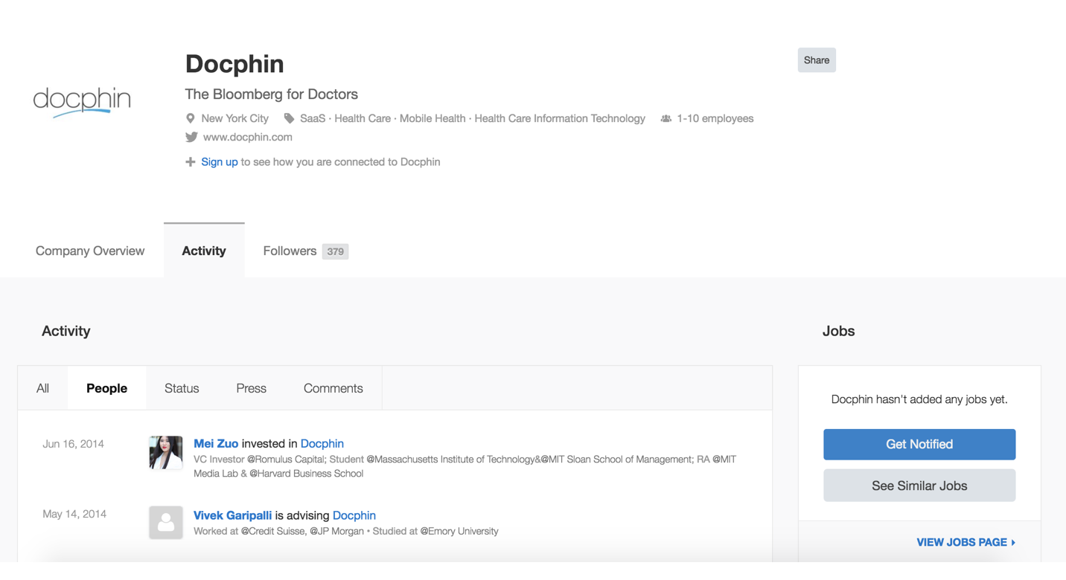
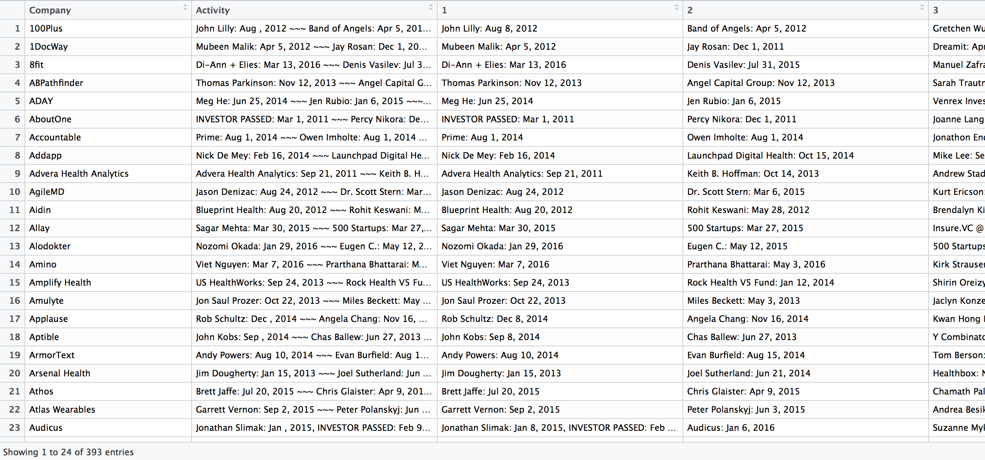
With More Time…..
Analyze activity page:
Time Series analysis (density of investment, identity of investor)
Investor analysis
Press Analysis
Machine Learning on early investor/press activity to predict success
Success metric: number of employees after certain amount of time? Valuation?

